Slide 1
Atrocities of the Spanish Civil War: The Execution of the Thirteen Roses in 1939.
Yury De Santos
Advisor: Dr. Urioste

Slide 2
Some books where the Thirteen Roses are mention.
“Asesinato legal (5 de agosto de 1939). Las Trece Rosas” by Jacobo García Blanco-Cicerón (1985).
“Cárcel de mujeres” by Tomasa Cuevas (1985)
“Trece Rosas Rojas” by Carlos Fonseca (2005)
“Las trece rosas” by Jesús Ferrero (2003)
“Martina la rosa número trece” by Ángeles López (2006)

Slide 3
Second Republic (1931-1939)
The Constitution of 1931
Right for women to vote
Equal education for everyone
Equal opportunities for jobs
Divorce rights
Civil union
Freedom of Speech
Disestablish religion on education (Catholicism)

Slide 4
Spanish Civil War (1936-1939)
In July, 1936 a military uprising led by Francisco Franco
Intended to seize power immediately
Encounter a strong resistance
Franco instead of declaring the coup a failure, initiated a war against the Second Republic.
A bloody war that lasted three long years, where Spain was divided in two:
The Republicans, the reds (Spain’s leftist)
The Nationalist (Spain’s rightist)

Slide 5
Spain’s Post Civil War
The Nationalist prevail and Franco’s regime begun on April 1, 1939. (It meant death, repression and exile for the reds)
The repression and persecution against the reds begun. (The cleaning up of the barbarians)
Improvise concentration camps, and Jails were over populated with political prisoner
The Thirteen Roses were victims of the repression against the reds.

Slide 6
The Thirteen Roses
Thirteen females between the ages of 18-29.
The majority were underage (21)
Only one of them was married
Most of them form part of the Juventudes Socialistas Unificadas (JSU)
A group fighting against Franco’s regime, who supported the Second Republic democracy.

Slide 7
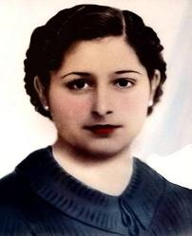
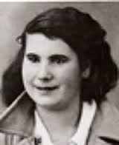
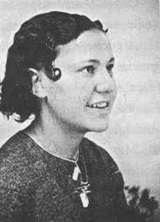
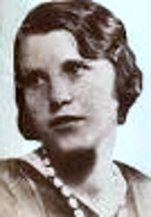
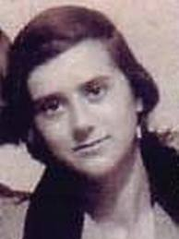
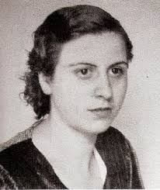
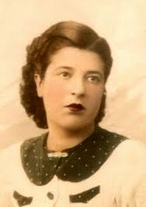
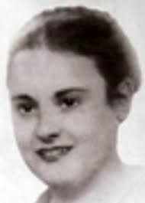
The minors: Virtudes González García, Luisa Rodríguez de la Fuente, Julia Conesa Conesa, Carmen Barrero Aguado, Dionisia Manzanero Salas, (Victoria Muñoz García, Adelina García Casillas, Elena Gil Olaya).
The adults: Ana López Gallego, Martina Barroso García, Blanca Brisac Vázquez, (Joaquina López Laffite, y Pilar Bueno Ibáñez).

Slide 8
The Thirteen Roses
These females step up to work, while man were fighting at the front line.
They occupy high raking positions in the JSU
These females would transport fire arms, important documents, and information during the Post War.

Slide 9
The Thirteen Roses
They were detained by Franco’s regime because either a neighbor told on them, or someone who knew them from the JSU.
The civil guard told the family that they were going to be back in a couple of hours
They never return home

Slide 10
The Thirteen Roses
They were taken to different improvise detention centers.
They were interrogated
Torture
Rape
Then they were transfer to “Cárcel de Ventas” (Prison), to wait for their trial in a court-martial.
But the interrogations did not stop.

Slide 11
Life in Prison (Cárcel de Ventas)
The prison capacity was for 450 prisoners, there were more than 4,000 prisoners.
When they first arrived they were issue: a plate, spoon and a blanket. The mattress had to be provided by the family.
They only had one meal per day.
They did not had running water.
The minors were separated from everyone else.
They suffer from hunger and poor hygiene which cause: scabies, parasites, and vitamin deficiency.

Slide 12
The murder of a high ranking officer
The Major Gabaldon’s assassination by a member of the JSU, was an excuse to trial 58 prisoners who had nothing to do with the assassination.
The 58 prisoners were in prison when the assassination took place. (15 Females, 43 males)
They were tried in a brief court-martial on August 4th, 1939
57 were given the death penalty, one female got 12 years in prison. (It was the first time minors were given the death penalty).

Slide 13
Franco’s Justice would fall on the detainees and on that group of girls who were serving for months in Ventas prison, who were members of
the JSU, the same communist organization, all accomplices and all enemies of the nation. It did not matter that some of them could not materially had been part of Gabaldo’s assassination. (Fonseca 222)

Slide 14
The Execution
Early in the morning the military went to the prison for the 13 females
The cemetery was really close by (place of execution)
It was convenient to bury them
They were buried in mass graves
The prisoners could heard the machine gun from prison

Slide 15
The Execution
On the August 5th 1939, 56 prisoners were executed.
The Thirteen Roses were executed,
They were executed just hours after the trial
No one notify their families
In the news papers it only say that 56 were executed
Never mention there were females and minors in that group.

Slide 16
The Thirteen Roses
“The Thirteen Roses” and “The Minors” were names given to them by their fellow prisoners.
Who kept telling their story.
The families found out when they went to visit them to prison
The guard would give them their belongings, and notify them then

Slide 17
Franco’s Regime (1939-1975)
It was forbidden to talk about the “reds”, “barbarians”
Women main and only role: house keeper
Take care of husband
Have children
Women education:
General education from 6-12 years old
After 12 years old they were taught the house chores

Slide 18
The Second Republic was a strong foundation for today’s Democracy.
Today In Spain women are as independent and free as the Second Republic’s women.

Slide 19
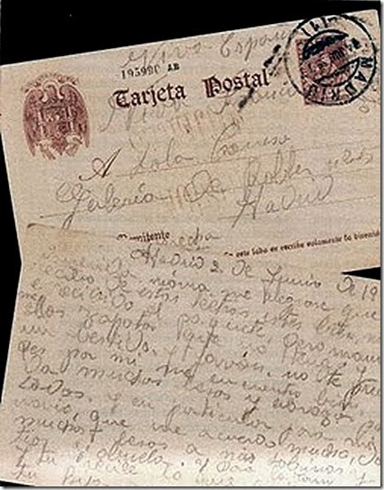
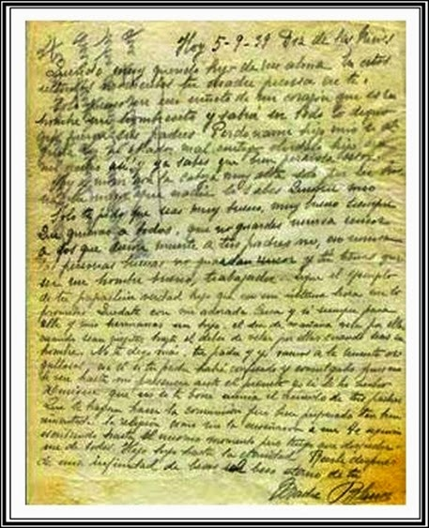
Keep in mind that I am not dying for being a criminal nor a thief, but for an idea. By Dionisia Manzanero (Fonseca 284)
What I only ask of you is to be a good person, be good always. Like everyone and never resent those who killed your parents, never. By Blanca Brisac (Fonseca 297)
Kisses for everyone, nor you or my friends weep. Don’t le my name be erased from history. By Julia Conesa (Fonseca 296)

Slide 20
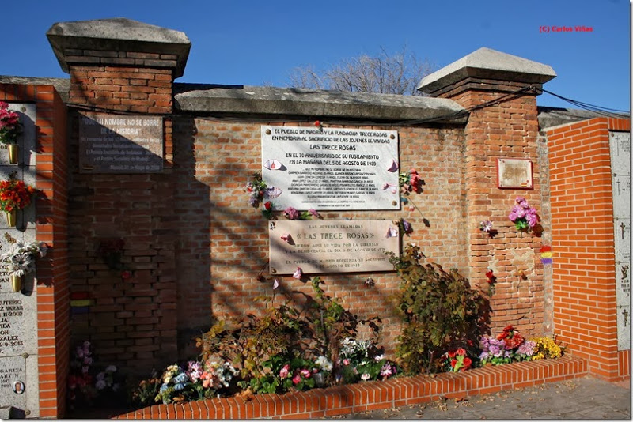
Monument for the Thirteen Roses

Slide 21
QUESTIONS
?

Slide 22
Bibliography
Fonseca, Carlos. Trece rosas rojas: la historia mas conmovedora de la guerra civil. Madrid: Temas de Hoy, 2004. Print.
Ferrero, Jesús. Las trece rosas. Spain: Ediciones Siruela, S.A., 2003. Print.
Capelmartínez, Rosa Ma. “De Protagonistas a Represaliadas: La Experiencia De Las Mujeres Republicanas.” Cuadernos De Historia Contemporánea, (2007): 35.

